Slide 1
AI/ML Professional Training Program: INNOQUEST Cohort-1
Instructor
Dr. Ahmad Raza Shahid
Professor, Department of Computer Science
FAST National University of Computer and Emerging Sciences
AI/ML Professional Training Program: INNOQUEST COHORT-1
Instructor: Prof. Ahmad Raza Shahid

Slide 2
Outline
Classification
Decision Boundary
Train/Test Split
Bias-Variance Trade-off
Evaluation Metrics
SVM for Classification
Decision Tree
Classification
Regression
Ensemble Learning
Random Forests
XGboost
AI/ML Professional Training Program: INNOQUEST COHORT-1
Instructor: Prof. Ahmad Raza Shahid

Slide 3
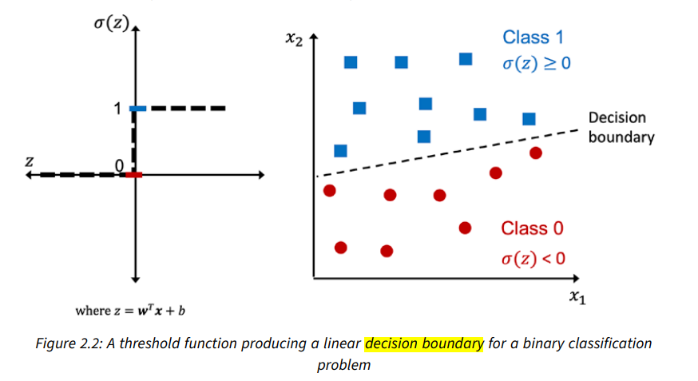
Decision Boundary
A decision boundary is a line or surface that separates data points into different classes in a classifier. It shows where the algorithm changes its prediction from one class to another based on the input features.
Types of Decision Boundaries:
Linear: A straight line or flat plane, used by algorithms like Logistic Regression or Linear Support Vector Machines (SVM).
Non-linear: Curved or complex shapes, handled by algorithms like k-Nearest Neighbors, Decision Trees, or Neural Networks.
AI/ML Professional Training Program: INNOQUEST COHORT-1
Instructor: Prof. Ahmad Raza Shahid

Slide 4
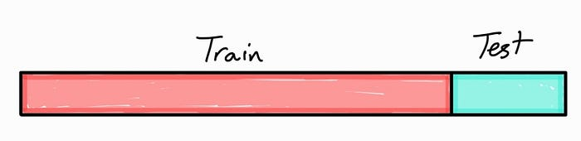
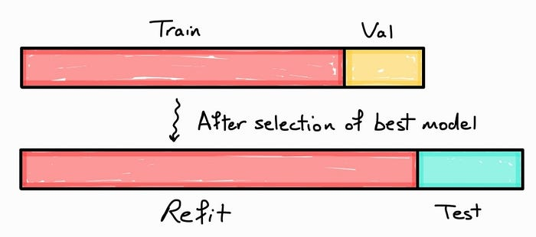
Train/Test Splits
What is Train-Test Split?
Divides the dataset into:
Training Set: Used to train the model.
Test Set: Used to evaluate performance on unseen data.
80:20, 70:30, or 75:25, depending on the dataset size.
Why it’s Important:
Prevents the model from memorizing the data instead of learning patterns.
Provides an unbiased measure of the model’s performance.
Shuffling and Stratification:
Shuffling: Randomly reorder data before splitting to avoid bias.
Stratified Splits: Maintain the same class distribution in training and test sets (important for imbalanced datasets).
AI/ML Professional Training Program: INNOQUEST COHORT-1
Instructor: Prof. Ahmad Raza Shahid

Slide 5
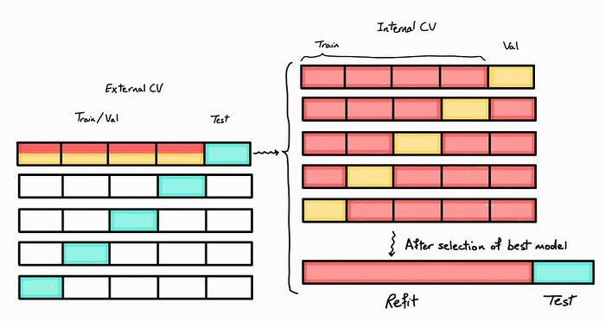
K-fold Cross Validation
Cross-Validation
What is Cross-Validation?
A technique to evaluate model performance more reliably by using multiple train-test splits.
k-Fold Cross-Validation:
Dataset is divided into k equal parts (folds).
The model is trained on k-1 folds and tested on the remaining fold.
Process repeats k times, with each fold used as a test set once.
Final performance is the average across all folds.
Benefits of Cross-Validation:
Provides a more comprehensive evaluation of the model.
Reduces the risk of overfitting or underfitting due to a single train-test split.
AI/ML Professional Training Program: INNOQUEST COHORT-1
Instructor: Prof. Ahmad Raza Shahid

Slide 6
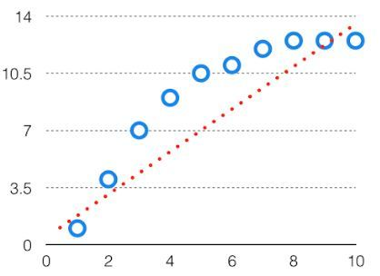
Bias-Variance Trade-off
Bias:
Measures the error due to overly simplistic assumptions in the model.
High bias leads to underfitting (poor performance on both training and test data).
Example: A linear model for non-linear data.
AI/ML Professional Training Program: INNOQUEST COHORT-1
Instructor: Prof. Ahmad Raza Shahid

Slide 7
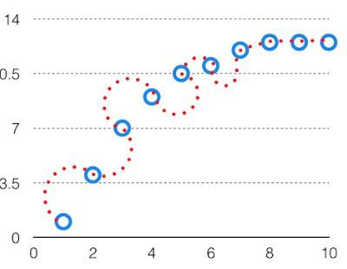
Variance
Variance:
Measures the variability of model predictions across different datasets.
High variance leads to overfitting (excellent on training data but poor on test data).
Example: A very complex model that fits noise in the training data.
AI/ML Professional Training Program: INNOQUEST COHORT-1
Instructor: Prof. Ahmad Raza Shahid

Slide 8
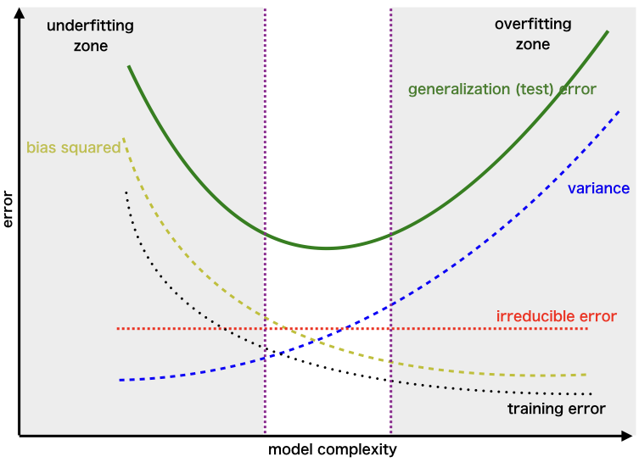
Trade-off
Trade-off:
A model must balance bias and variance to minimize total error: Total Error = Bias² + Variance + Irreducible Error.
Low bias increases variance, and low variance increases bias.
The goal is to find the optimal complexity that minimizes total error.
Impact on Model Complexity:
High Bias: Simple models (e.g., linear regression).
High Variance: Complex models (e.g., high-degree polynomial regression).
Optimal Trade-off: A model that captures patterns but avoids fitting noise
AI/ML Professional Training Program: INNOQUEST COHORT-1
Instructor: Prof. Ahmad Raza Shahid

Slide 9
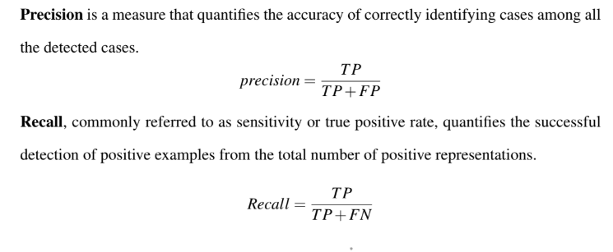
Evaluation Metrics
AI/ML Professional Training Program: INNOQUEST COHORT-1
Instructor: Prof. Ahmad Raza Shahid

Slide 10
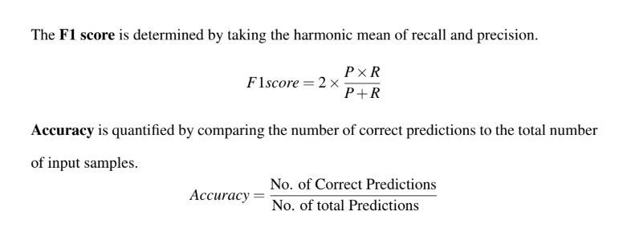
Evaluation Metrics
AI/ML Professional Training Program: INNOQUEST COHORT-1
Instructor: Prof. Ahmad Raza Shahid

Slide 11
Evaluation Metrics
True Positive (TP): The model correctly predicts a positive class when the actual class is positive.
True Negative(TN): The model correctly predicts a negative class when the actual class is negative.
False Positive(FP): The model incorrectly predicts a positive class when the actual class is negative.
False Negative (FN): The model incorrectly predicts a negative class when the actual class is positive.
AI/ML Professional Training Program: INNOQUEST COHORT-1
Instructor: Prof. Ahmad Raza Shahid

Slide 12
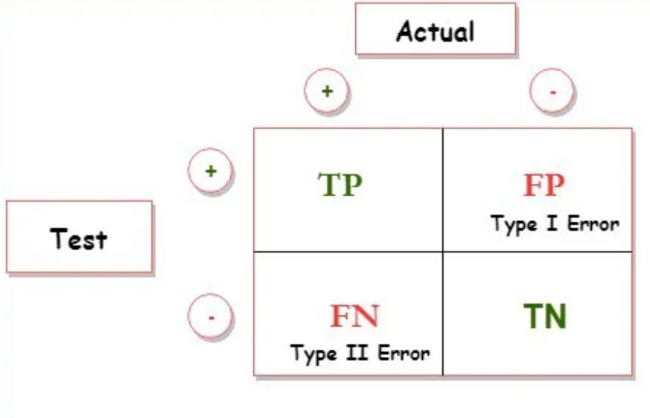
Confusion Metrics
A confusion matrix is a table that outlines different predictions and test results and contrasts them with real-world values.
AI/ML Professional Training Program: INNOQUEST COHORT-1
Instructor: Prof. Ahmad Raza Shahid

Slide 13
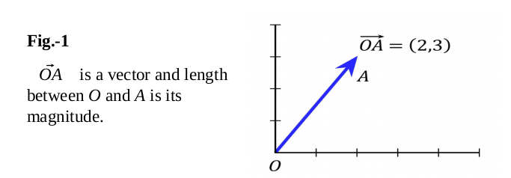
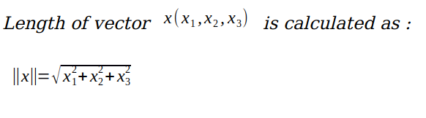
SVM
Basic Linear Algebra
Vectors: Vectors are mathematical quantity which has both magnitude and direction. A point in the 2D plane can be represented as a vector between origin and the point.
Length of Vectors: Length of vectors are also called as norms. It tells how far vectors are from the origin.
Fig.1: Vectors
[1] https://ankitnitjsr13.medium.com/math-behind-support-vector-machine-svm-5e7376d0ee4d
AI/ML Professional Training Program: INNOQUEST COHORT-1
Instructor: Prof. Ahmad Raza Shahid
Notes:
Energy management is doing more with the same amount of energy or less energy [1].

Slide 14
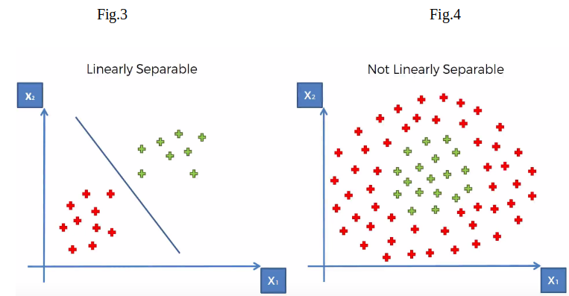
Hyper-plane
It is plane that linearly divide the n-dimensional data points in two component. In case of 2D, hyperplane is line, in case of 3D it is plane.
It is also called as n-dimensional line. Fig.2 shows, a blue line(hyperplane) linearly separates the data point in two components.
In the Fig.2, hyperplane is line divides data point into two classes(red & green), written as
Fig.2: Linearly Separable
Fig.3: Non-Linearly Separable
[1] https://ankitnitjsr13.medium.com/math-behind-support-vector-machine-svm-5e7376d0ee4d
AI/ML Professional Training Program: INNOQUEST COHORT-1
Instructor: Prof. Ahmad Raza Shahid
Notes:
Energy management is doing more with the same amount of energy or less energy [1].

Slide 15
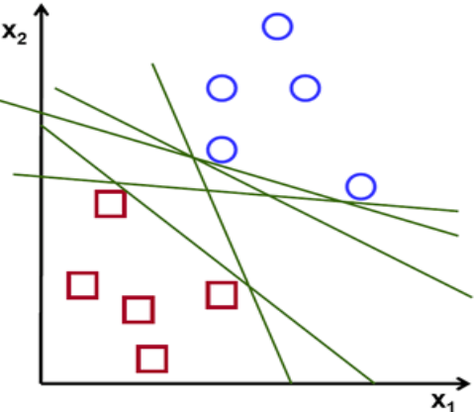
Optimal Hyperplane
If you look below Fig.4 there are numbers of hyperplane that can separate the data points in two components.
So optimal hyperplane is one which divides the data points very well. So, question is why it is needed to choose optimal hyper plane?
So, if you choose sub-optimal hyperplane, no doubt after number of training iteration , training error will decrease but during testing when an unseen instance will come, it will result in high test error.
In that case it is must to choose an optimal plane to get good accuracy.
Fig 4: Different Hyperplanes
AI/ML Professional Training Program: INNOQUEST COHORT-1
Instructor: Prof. Ahmad Raza Shahid
Notes:
Energy management is doing more with the same amount of energy or less energy [1].

Slide 16
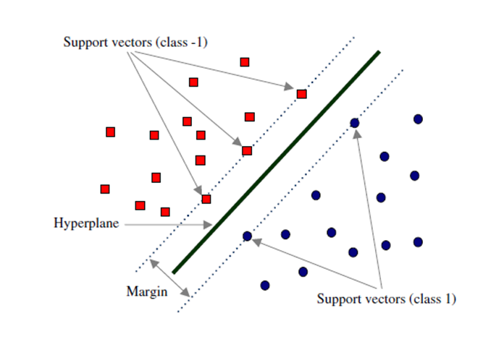
How to choose Optimal Hyperplane? (1/2)
Margin and Support Vectors
Let’s assume that solid black line in above Fig.5 is optimal hyperplane and two dotted line is some hyperplane, which is passing through nearest data points to the optimal hyperplane.
Then distance between hyperplane and optimal hyperplane is know as margin, and the closest data-points are known as support vectors.
Margin is an area which do not contains any data points. There will be some cases when we have data points in margin area but right now we stick to margin as no data points lands.
Fig.5: Margin and Support Vectors
AI/ML Professional Training Program: INNOQUEST COHORT-1
Instructor: Prof. Ahmad Raza Shahid
Notes:
Energy management is doing more with the same amount of energy or less energy [1].

Slide 17
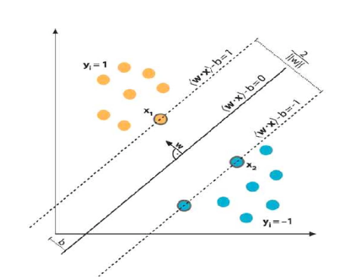
How to choose Optimal Hyperplane? (2/2)
Margin and Support Vectors
So, when we are choosing optimal hyperplane, we will choose one among set of hyperplane which is highest distance from the closest data points.
If optimal hyperplane is very close to data points, then margin will be very small, and it will generalize well for training data but when an unseen data will come it will fail to generalize well as explained above.
So ,our goal is to maximize the margin so that our classifier is able to generalize well for unseen instances.
So, In SVM our goal is to choose an optimal hyperplane which maximizes the margin.
Mathematical Interpretation of Optimal Hyperplane
Fig .6: Optimal Hyperplane
AI/ML Professional Training Program: INNOQUEST COHORT-1
Instructor: Prof. Ahmad Raza Shahid
Notes:
Energy management is doing more with the same amount of energy or less energy [1].

Slide 18
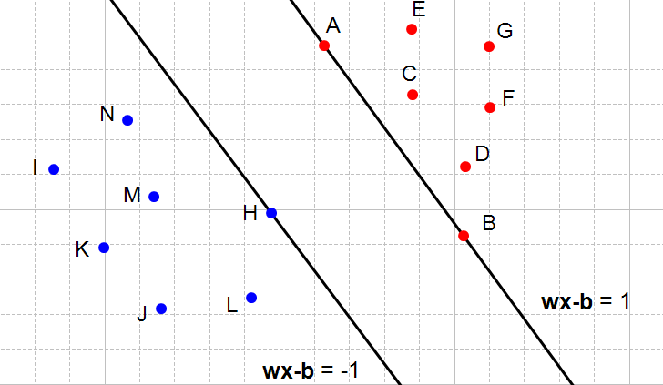
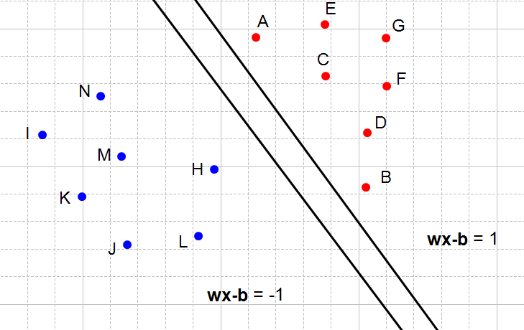
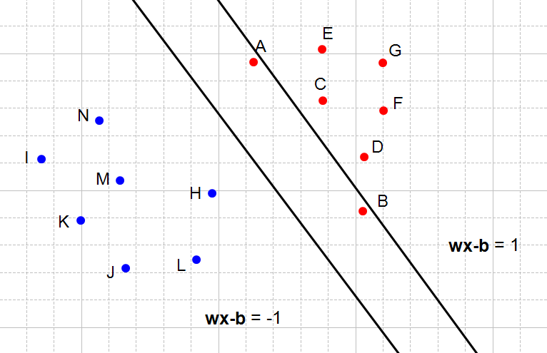
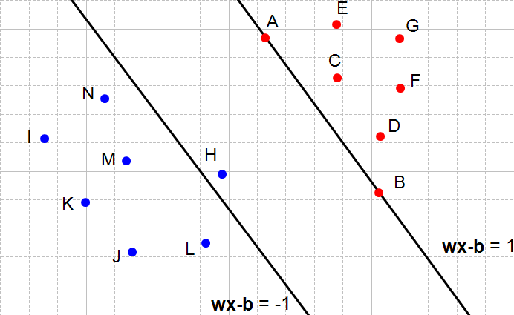
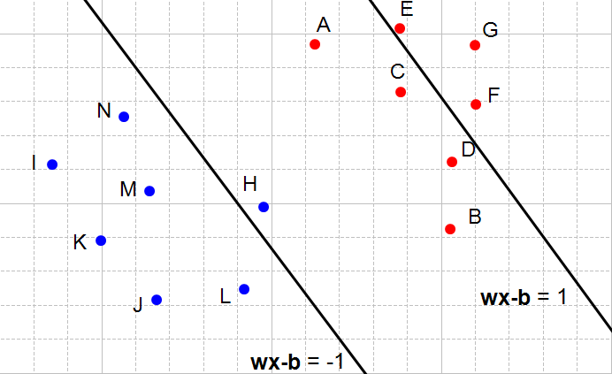
How can we find the biggest margin? (6/14)
Fig 7: Two hyperplanes satisfying the constraints
Fig 8: Two hyperplanes also satisfying the constraints
Fig 9: The right hyperplane does not satisfy the first constraint
Fig 10: The left hyperplane does not satisfy the second constraint
Fig11: Both constraint are not satisfied
AI/ML Professional Training Program: INNOQUEST COHORT-1
Instructor: Prof. Ahmad Raza Shahid

Slide 19
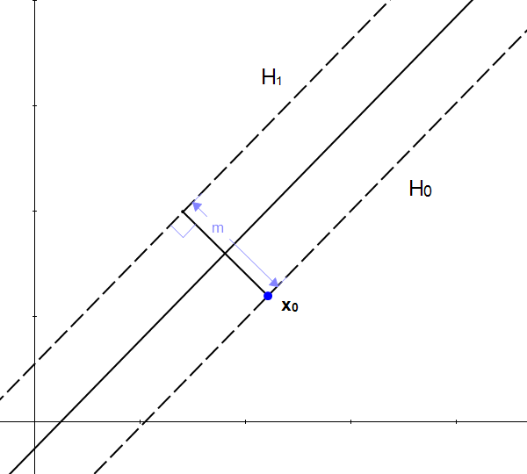
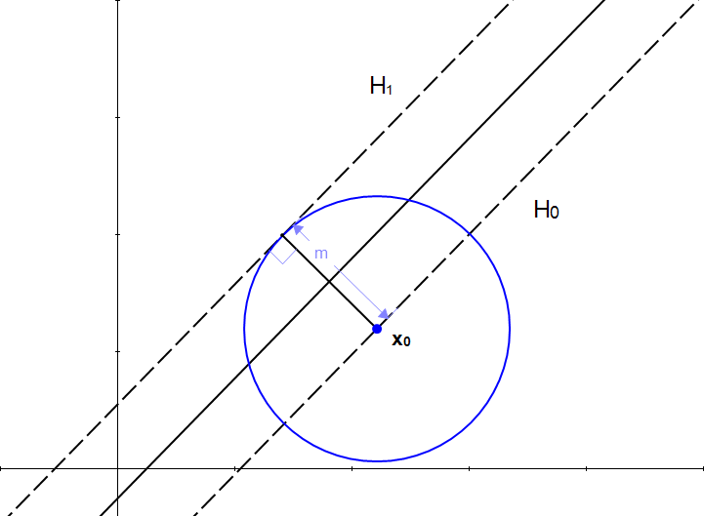
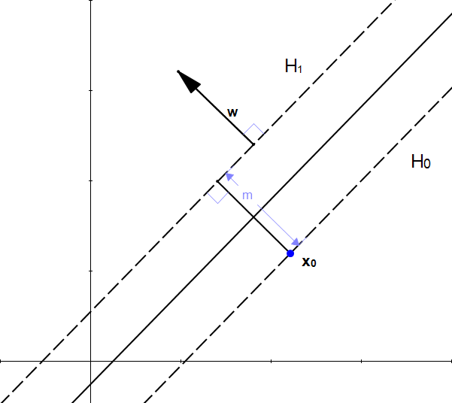
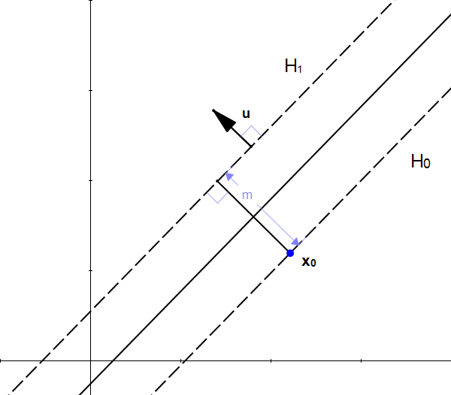
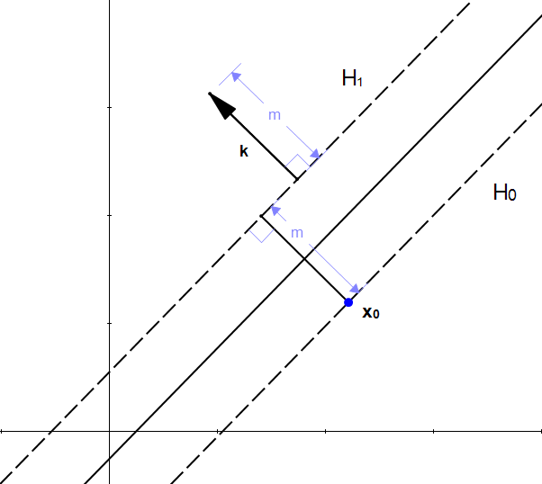
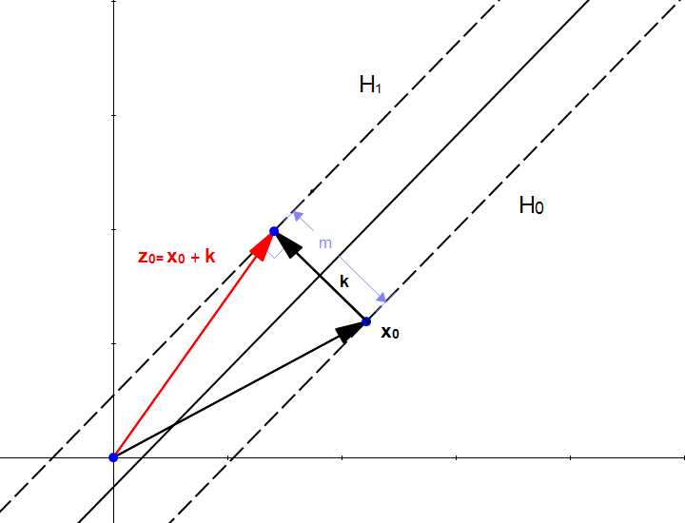
How can we find the biggest margin? (11/14)
Fig 12: m is the distance between the two hyperplanes
Fig 13 All points on the circle are at the distance m from x0
Fig 14: w is perpendicular to H1
Fig 15: u is also is perpendicular to H1
Fig16: k is a vector of length m perpendicular to H1
Fig 17: z0 is a point on H1
AI/ML Professional Training Program: INNOQUEST COHORT-1
Instructor: Prof. Ahmad Raza Shahid

Slide 20
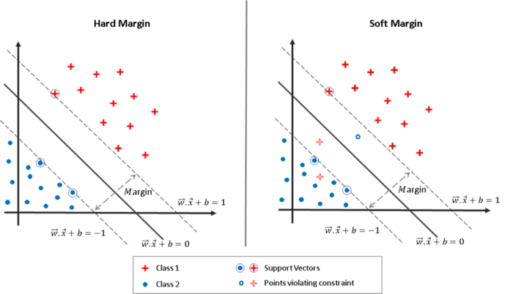
Vanilla (Plain) SVM & its Objective Function
So, what do these constraints mean?
It means that there can be no points inside of the hyperplane as shown in the below figure and this is called Hard Margin SVM (Vanilla SVM).
This is the big drawback of SVMs! The two classes need to be fully separable. This is never the case in real-world datasets! This is where Soft Margin SVMs come into play.
Do SVMs use Gradient Descent to find the minima? No way! (Most people fail to know this). The minima is directly found by solving derivatives of the Objective function.
Since there are constraints, we’ll need to first take the Langrangian of the Objective Function to solve for the minima.
Fig.18: Hard Margin
Fig 19: Soft Margin
[2] https://towardsdatascience.com/support-vector-machines-dual-formulation-quadratic-programming-sequential-minimal-optimization-57f4387ce4dd
AI/ML Professional Training Program: INNOQUEST COHORT-1
Instructor: Prof. Ahmad Raza Shahid
Notes:
Energy management is doing more with the same amount of energy or less energy [1].

Slide 21
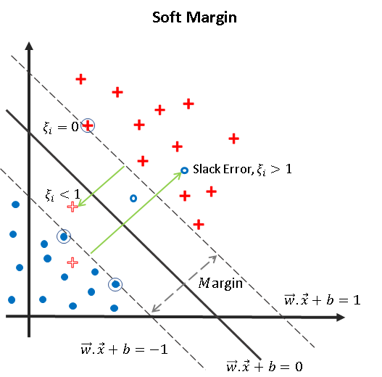
Soft Margin SVM (1/2)
As mentioned above, Soft Margin SVMs can handle classes with inseparable datapoints. The figure below explains the same clearly!
So, here’s the gist of the idea behind Soft Margin:
To allow the SVM to make some mistakes and yet keep the margin as wide as possible.
Fig20: Soft Margin
AI/ML Professional Training Program: INNOQUEST COHORT-1
Instructor: Prof. Ahmad Raza Shahid
Notes:
Energy management is doing more with the same amount of energy or less energy [1].

Slide 22
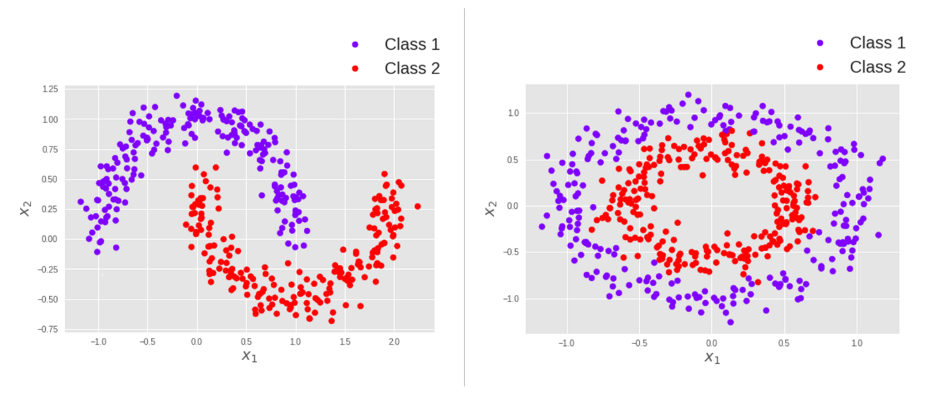
The Kernel Trick (1/2)
The Kernel Trick
Now looking back at what we’ve derived, it is clear that we are only using w.x+b. This is simply only a linear equation. That means SVM works best when you can classify the data linearly!
That is another really huge limitation! However, the authors have found a hack for this & that’s the kernel trick. In simplistic terms:
Fig 21: Kernel Trick
[2] https://towardsdatascience.com/support-vector-machines-dual-formulation-quadratic-programming-sequential-minimal-optimization-57f4387ce4dd
AI/ML Professional Training Program: INNOQUEST COHORT-1
Instructor: Prof. Ahmad Raza Shahid
Notes:
Energy management is doing more with the same amount of energy or less energy [1].

Slide 23
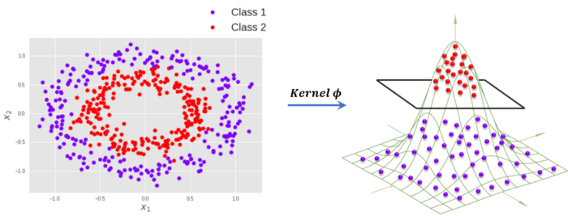
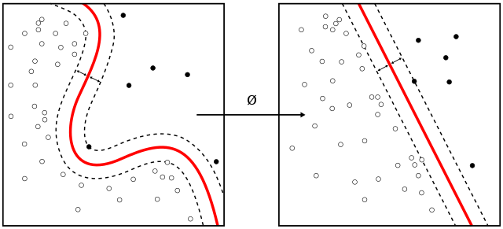


The Kernel Trick (2/2)
The Kernel simply converts the non-linear datapoints to linear datapoints, so that the SVM can bisect two classes.
The same is shown in the below figure.
Hence the new line equation would be
Here, a neat trick is used to convert the points in n-dimension to N-dimension where N>n.
The Kernel 𝜑 must obey the following conditions:
Fig22: Non-linear to Linear Datapoints
Fig23: Non-linear to Linear Datapoints
(8)
AI/ML Professional Training Program: INNOQUEST COHORT-1
Instructor: Prof. Ahmad Raza Shahid
Notes:
Energy management is doing more with the same amount of energy or less energy [1].

Slide 24




Kernel Functions
There are several kernel functions used for SVMs. Some of the popular ones are:
Gaussian Radial Basis Function (RBF):
where 𝛾 > 0.
A special case is 𝛾 = 1/2𝜎²
Gaussian Kernel:
Polynomial Kernel:
Sigmoid kernel:
AI/ML Professional Training Program: INNOQUEST COHORT-1
Instructor: Prof. Ahmad Raza Shahid
Notes:
Energy management is doing more with the same amount of energy or less energy [1].

Slide 25
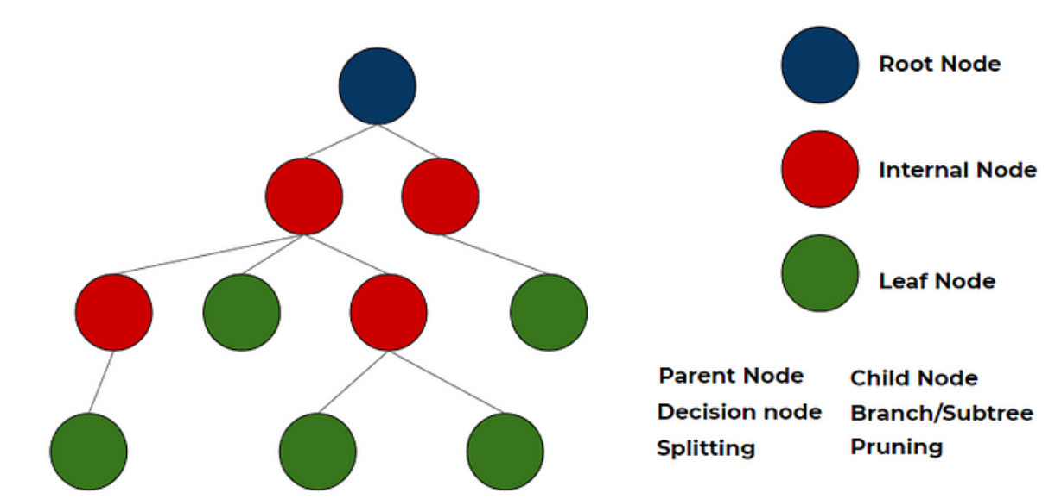
Decision trees
Parent node: In any two connected nodes, the one which is higher hierarchically, is a parent node.
Root node: The starting node from which the tree starts, It has only child nodes. The root node does not have a parent node.
Leaf Node/leaf: Nodes at the end of the tree, which do not have any children are leaf nodes or called simply leaf.
AI/ML Professional Training Program: INNOQUEST COHORT-1
Instructor: Prof. Ahmad Raza Shahid

Slide 26
Decision trees
Regression Tree
A regression tree is used when the dependent variable is continuous. The value obtained by leaf nodes in the training data is the mean response of observation falling in that region. Thus, if an unseen data observation falls in that region, its prediction is made with the mean value. This means that even if the dependent variable in training data was continuous, it will only take discrete values in the test set. A regression tree follows a top-down greedy approach
Classification Tree
A classification tree is used when the dependent variable is categorical. The value obtained by leaf nodes in the training data is the mode response of observation falling in that region It follows a top-down greedy approach.
AI/ML Professional Training Program: INNOQUEST COHORT-1
Instructor: Prof. Ahmad Raza Shahid

Slide 27
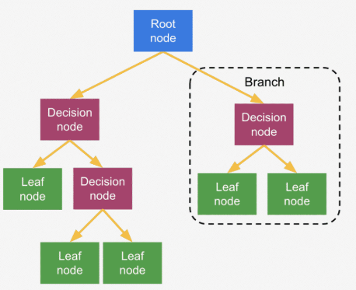
Regression Tree
A Regression Tree is a decision tree used for predicting continuous values (i.e., regression tasks). It partitions the input feature space into regions and predicts the target value for each region. Here's a breakdown of how regression trees work and their components:
1. Tree Structure:
Nodes: Each internal node represents a decision based on a feature, and each leaf node represents a predicted value.
Splitting Criteria: The tree splits the data based on a feature that minimizes the error or variance within the resulting groups.
Leaf Nodes: Each leaf node contains the predicted target value, which is typically the mean of the target values of the training samples that fall into that leaf.
AI/ML Professional Training Program: INNOQUEST COHORT-1
Instructor: Prof. Ahmad Raza Shahid

Slide 28
Regression Tree
Applications of Regression Trees:
Financial Forecasting: Predicting stock prices, housing prices, etc.
Environmental Modeling: Predicting climate changes or pollution levels.
Healthcare: Estimating patient outcomes, disease progression, etc.
Product Pricing: Setting prices based on various product features and market conditions.
AI/ML Professional Training Program: INNOQUEST COHORT-1
Instructor: Prof. Ahmad Raza Shahid

Slide 29
Decision trees
A method for approximating discrete-valued functions that is robust to noisy data and capable of learning disjunctive expressions
ID3, ASSISTANT, C4.5, J48 (Weka)
Learn a completely expressive hypothesis space
Inductive bias is a preference for smaller trees over larger ones
AI/ML Professional Training Program: INNOQUEST COHORT-1
Instructor: Prof. Ahmad Raza Shahid

Slide 30
Decision trees
They classify instances by sorting them down the tree from the root to some leaf node
Leaf node provides the classification of the instance
Each node in the tree specifies a test of some attribute of the instance, and each branch descending from that node corresponds to one of the possible values for this attribute
AI/ML Professional Training Program: INNOQUEST COHORT-1
Instructor: Prof. Ahmad Raza Shahid

Slide 31
Decision trees
Disjunctions of conjunctions of constraints on the attribute values of instances
Each path from the root to a leaf corresponds to a conjunction of attribute tests
Tree itself to a disjunction of these conjunctions
AI/ML Professional Training Program: INNOQUEST COHORT-1
Instructor: Prof. Ahmad Raza Shahid

Slide 32
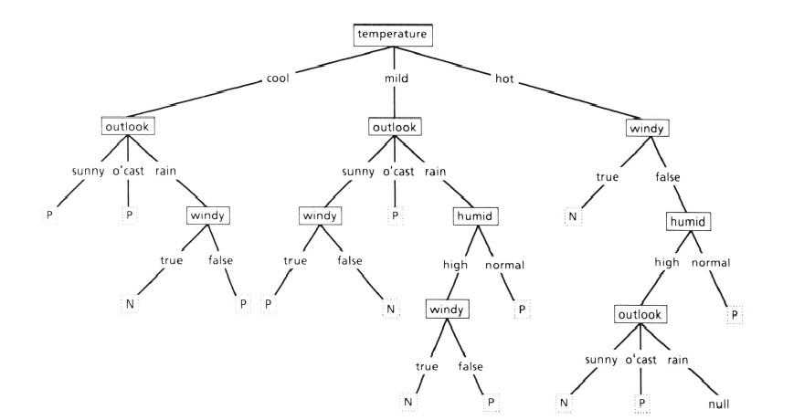
A more complex decision tree
AI/ML Professional Training Program: INNOQUEST COHORT-1
Instructor: Prof. Ahmad Raza Shahid

Slide 33
Decision trees – appropriate problems
Attribute-value pairs
Fixed set of attributes and their values
Easiest is one it takes a small number of disjoint values
However, real valued attributes can be handled as well
Target function
Discrete output values
Boolean classification
However, can be extended to consider multiple outputs
AI/ML Professional Training Program: INNOQUEST COHORT-1
Instructor: Prof. Ahmad Raza Shahid

Slide 34
Decision trees – appropriate problems
Disjunctive descriptions
Naturally represent disjunctive expressions
Noisy training data
Robust to errors
Errors in classifications of the training examples
Errors in attribute values
Missing attribute values
Some of the attribute values are missing
AI/ML Professional Training Program: INNOQUEST COHORT-1
Instructor: Prof. Ahmad Raza Shahid

Slide 35
Decision trees – example problems
Learning to classify medical patients by their disease
Equipment malfunctions by their cause
Loan applicants by their likelihood of defaulting on payments
AI/ML Professional Training Program: INNOQUEST COHORT-1
Instructor: Prof. Ahmad Raza Shahid

Slide 36
Decision trees – the algorithm
Top-down greedy search through space of possible decision trees
The algorithm constructs the tree
“Which attribute should be tested at the root of the tree?”
Each instance attribute is evaluated using a statistical test to determine how well it alone classifies the training examples
AI/ML Professional Training Program: INNOQUEST COHORT-1
Instructor: Prof. Ahmad Raza Shahid

Slide 37
Decision trees – the algorithm
A descendent of the root node is then created for each possible value of this attribute
Training examples are sorted to the appropriate descendant node (i.e., down the branch corresponding to the example’s value for this attribute)
The entire process is then repeated using the training examples associated with each descendant node to select the best attribute to test at that point in the tree
Greedy approach with no backtracking
AI/ML Professional Training Program: INNOQUEST COHORT-1
Instructor: Prof. Ahmad Raza Shahid

Slide 38
Which attribute is the best classifier?
Selection of the best attribute at each node is the key problem to be solved while creating the tree
How to measure the “goodness” of an attribute?
information gain
Measures how well a given attribute separates the training examples according to their target classification
The algorithm uses it to select among the candidate attribute at each step while building the tree
AI/ML Professional Training Program: INNOQUEST COHORT-1
Instructor: Prof. Ahmad Raza Shahid

Slide 39
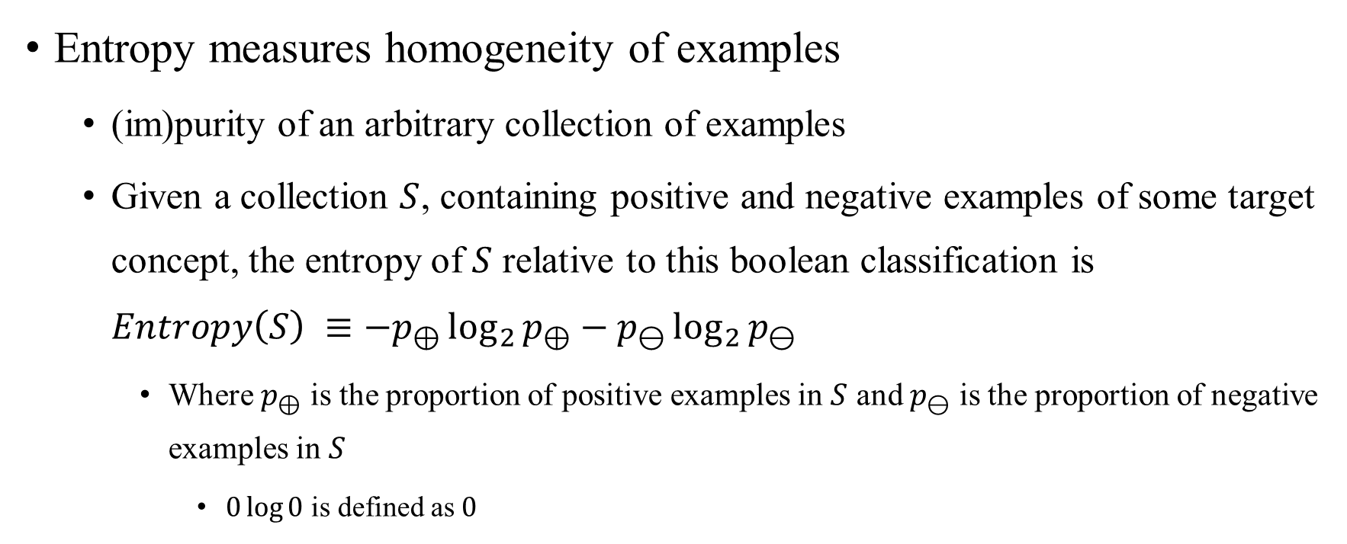
Entropy
Entropy measures homogeneity of examples
(im)purity of an arbitrary collection of examples
Given a collection $S$, containing positive and negative examples of some target concept, the entropy of $S$ relative to this boolean classification is $Entropy\left(S\right) ≡−p_{⊕}\log_{2}{p_{⊕}−p_{⊖}\log_{2}{p_{⊖}}}$
Where $p_{⊕}$ is the proportion of positive examples in $S$ and $p_{⊖}$ is the proportion of negative examples in $S$
$0\log{0}$ is defined as $0$
AI/ML Professional Training Program: INNOQUEST COHORT-1
Instructor: Prof. Ahmad Raza Shahid

Slide 40
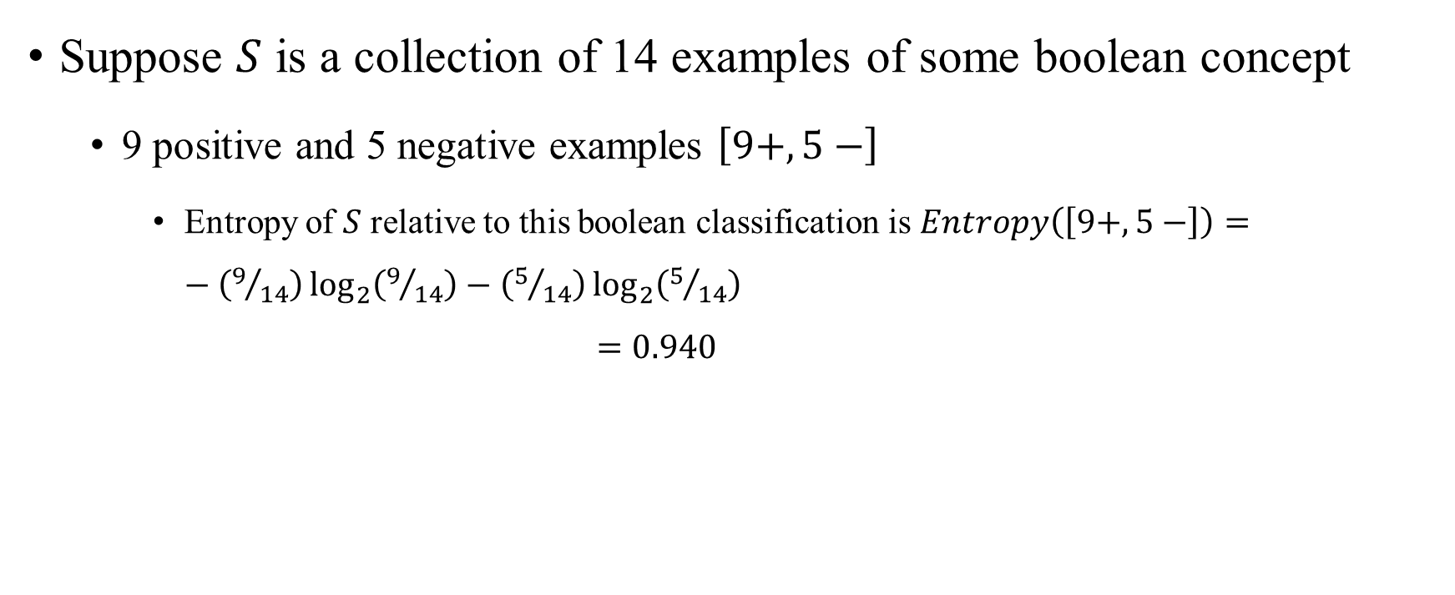
Entropy
Suppose $S$ is a collection of 14 examples of some boolean concept
9 positive and 5 negative examples $\left[9+,5−\right]$
Entropy of $S$ relative to this boolean classification is $Entropy\left(\left[9+,5−\right]\right)=−\left(9/{14}\right)\log_{2}\left(9/{14}\right)−\left(5/{14}\right)\log_{2}\left(5/{14}\right)$ $=0.940$
AI/ML Professional Training Program: INNOQUEST COHORT-1
Instructor: Prof. Ahmad Raza Shahid

Slide 41
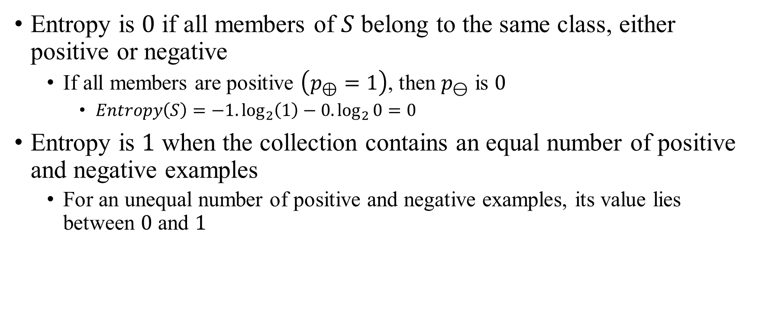
Entropy
Entropy is $0$ if all members of $S$ belong to the same class, either positive or negative
If all members are positive $\left(p_{⊕}=1\right)$, then $p_{⊖}$ is $0$
$Entropy\left(S\right)=−1.\log_{2}\left(1\right)−0.\log_{2}{0}=0$
Entropy is $1$ when the collection contains an equal number of positive and negative examples
For an unequal number of positive and negative examples, its value lies between $0$ and $1$
AI/ML Professional Training Program: INNOQUEST COHORT-1
Instructor: Prof. Ahmad Raza Shahid

Slide 42
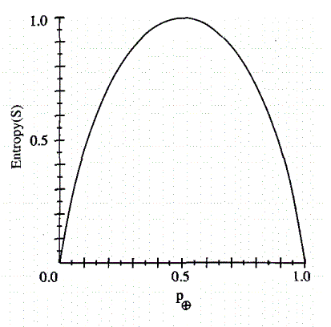
Entropy
Tom Motchell, page 57, figure 3.2
AI/ML Professional Training Program: INNOQUEST COHORT-1
Instructor: Prof. Ahmad Raza Shahid

Slide 43

Entropy
In general $Entropy\left(S\right) ≡ \sum_{i=1}^{c}{−p_{i}\log_{2}{p_{i}}}$
Where $p_{i}$ is the proportion of $S$ belonging to class $i$
AI/ML Professional Training Program: INNOQUEST COHORT-1
Instructor: Prof. Ahmad Raza Shahid

Slide 44
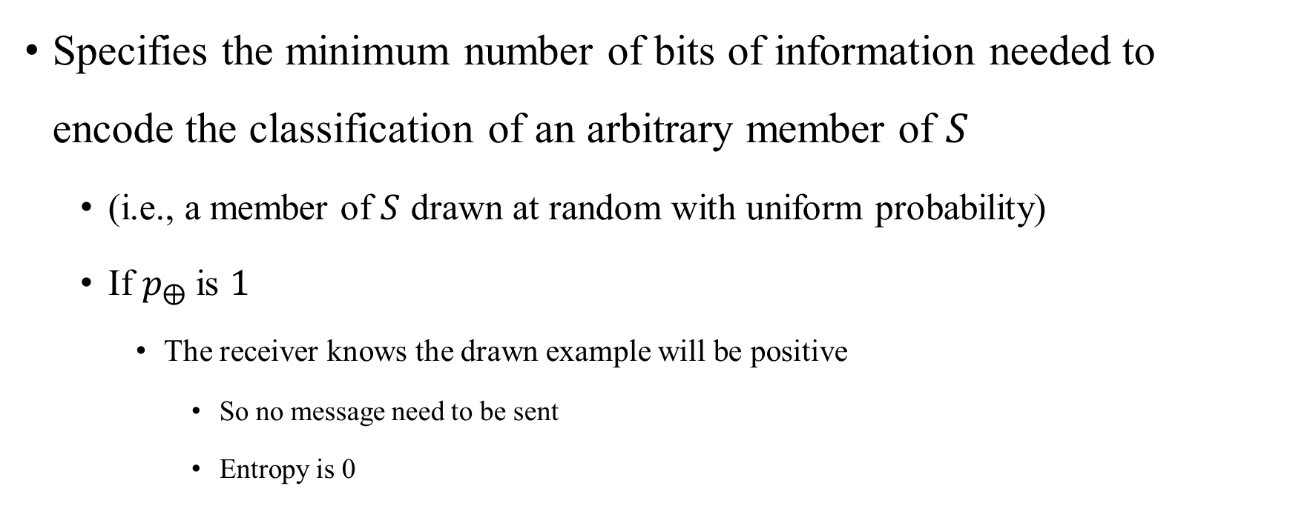
Entropy
Specifies the minimum number of bits of information needed to encode the classification of an arbitrary member of $S$
(i.e., a member of $S$ drawn at random with uniform probability)
If $p_{⨁}$ is $1$
The receiver knows the drawn example will be positive
So no message need to be sent
Entropy is 0
AI/ML Professional Training Program: INNOQUEST COHORT-1
Instructor: Prof. Ahmad Raza Shahid

Slide 45
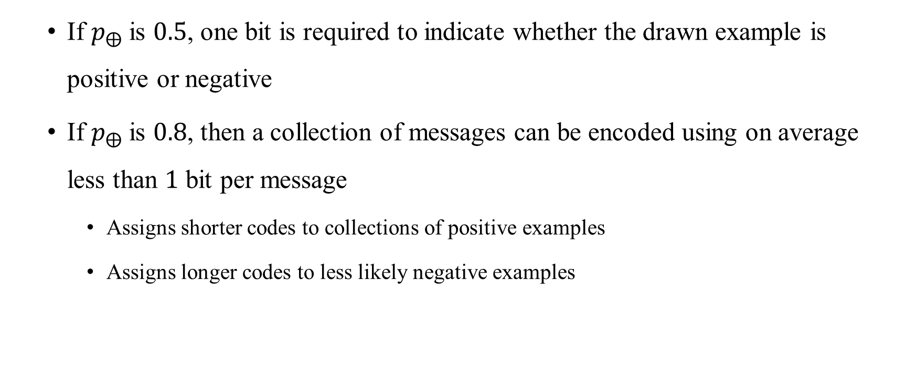
Entropy
If $p_{⨁}$ is $0.5$, one bit is required to indicate whether the drawn example is positive or negative
If $p_{⨁}$ is $0.8$, then a collection of messages can be encoded using on average less than $1$ bit per message
Assigns shorter codes to collections of positive examples
Assigns longer codes to less likely negative examples
AI/ML Professional Training Program: INNOQUEST COHORT-1
Instructor: Prof. Ahmad Raza Shahid

Slide 46
Information gain
The expected reduction in entropy by choosing a particular attribute over others for a particular node in the tree
It identifies how much impurity is removed in a set of examples if a particular attribute is chosen at a particular node
The aim is to reduce that impurity so that for a particular attribute constraint all the examples are either positive or negative
AI/ML Professional Training Program: INNOQUEST COHORT-1
Instructor: Prof. Ahmad Raza Shahid

Slide 47
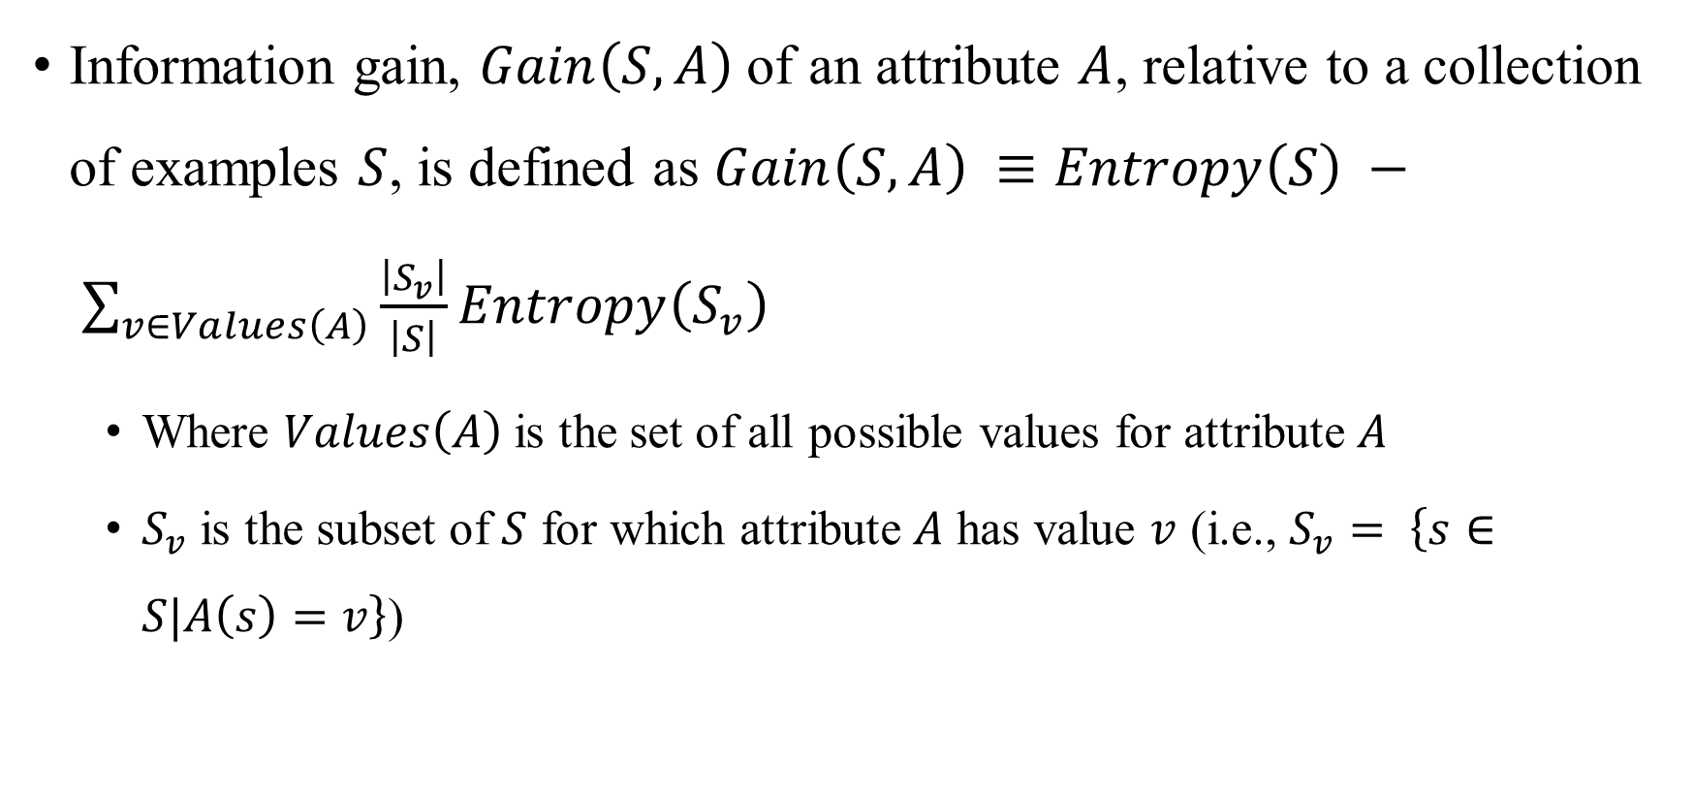
Information gain
Information gain, $Gain\left(S,A\right)$ of an attribute $A$, relative to a collection of examples $S$, is defined as $Gain\left(S,A\right) ≡Entropy\left(S\right) − \sum_{v∈Values\left(A\right)}{\frac{\left|S_{v}\right|}{\left|S\right|}Entropy\left(S_{v}\right)}$
Where $Values\left(A\right)$ is the set of all possible values for attribute $A$
$S_{v}$ is the subset of $S$ for which attribute $A$ has value $v$ (i.e., $S_{v}= \left\{s∈S|A\left(s\right)=v\right\}$)
AI/ML Professional Training Program: INNOQUEST COHORT-1
Instructor: Prof. Ahmad Raza Shahid

Slide 48
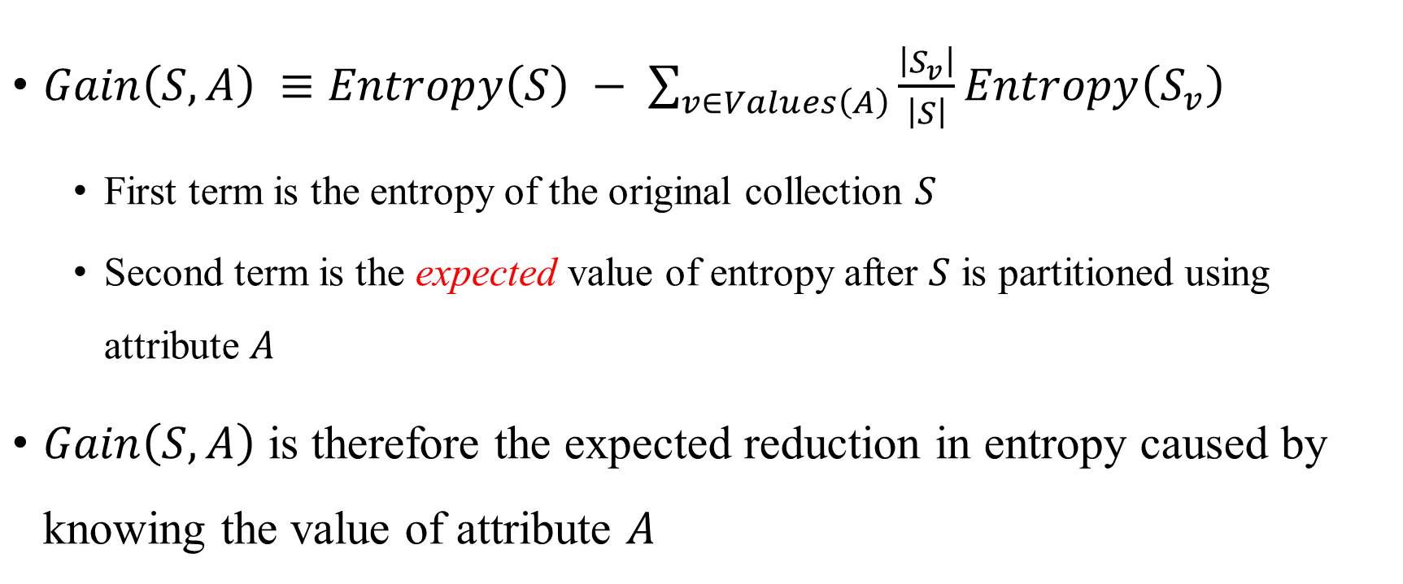
Information gain
$Gain\left(S,A\right) ≡Entropy\left(S\right) − \sum_{v∈Values\left(A\right)}{\frac{\left|S_{v}\right|}{\left|S\right|}Entropy\left(S_{v}\right)}$
First term is the entropy of the original collection $S$
Second term is the expected value of entropy after $S$ is partitioned using attribute $A$
$Gain\left(S,A\right)$ is therefore the expected reduction in entropy caused by knowing the value of attribute $A$
AI/ML Professional Training Program: INNOQUEST COHORT-1
Instructor: Prof. Ahmad Raza Shahid

Slide 49

Information Gain
The value of $Gain\left(S,A\right)$ is the number of bits saved when encoding the target value of an arbitrary member of $S$, by knowing the value of attribute $A$.
AI/ML Professional Training Program: INNOQUEST COHORT-1
Instructor: Prof. Ahmad Raza Shahid

Slide 50
Information gain
Day | Outlook | Temperature | Humidity | Wind | PlayTennis
D1 | Sunny | Hot | High | Weak | No
D2 | Sunny | Hot | High | Strong | No
D3 | Overcast | Hot | High | Weak | Yes
D4 | Rain | Mild | High | Weak | Yes
D5 | Rain | Cool | Normal | Weak | Yes
D6 | Rain | Cool | Normal | Strong | No
D7 | Overcast | Cool | Normal | Strong | Yes
D8 | Sunny | Mild | High | Weak | No
D9 | Sunny | Cool | Normal | Weak | Yes
D10 | Rain | Mild | Normal | Weak | Yes
D11 | Sunny | Mild | Normal | Strong | Yes
D12 | Overcast | Mild | High | Strong | Yes
D13 | Overcast | Hot | Normal | Weak | Yes
D14 | Rain | Mild | High | Strong | No

Slide 51
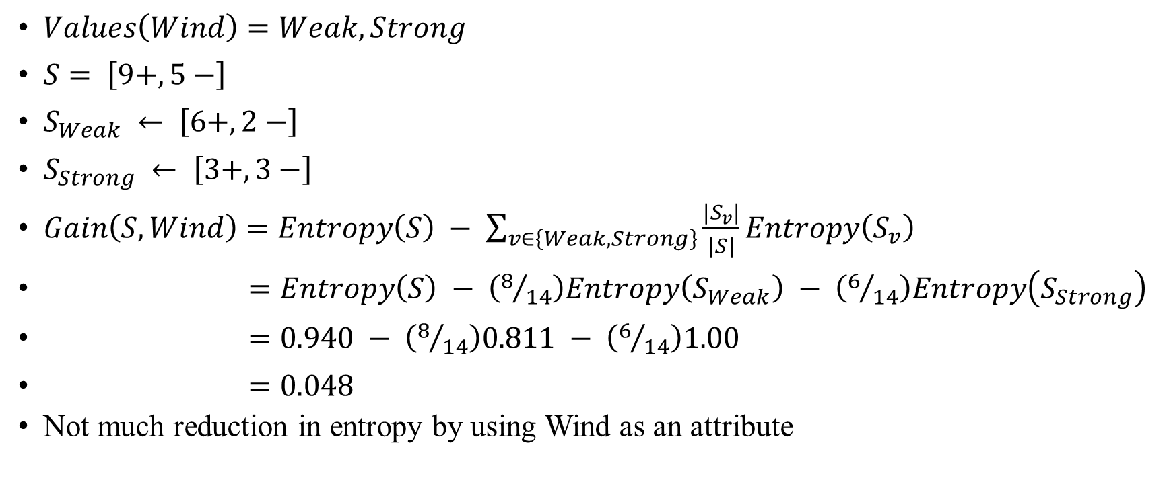
Information gain
$Values\left(Wind\right)=Weak, Strong$
$S= \left[9+,5−\right]$
$S_{Weak} ← \left[6+,2−\right]$
$S_{Strong} ← \left[3+,3−\right]$
$Gain\left(S,Wind\right)=Entropy\left(S\right) − \sum_{v∈\left\{Weak,Strong\right\}}{\frac{\left|S_{v}\right|}{\left|S\right|}Entropy\left(S_{v}\right)}$
$=Entropy\left(S\right) − \left(8/{14}\right)Entropy\left(S_{Weak}\right) − \left(6/{14}\right)Entropy\left(S_{Strong}\right)$
$=0.940 − \left(8/{14}\right)0.811 − \left(6/{14}\right)1.00$
$=0.048$
Not much reduction in entropy by using Wind as an attribute
AI/ML Professional Training Program: INNOQUEST COHORT-1
Instructor: Prof. Ahmad Raza Shahid

Slide 52
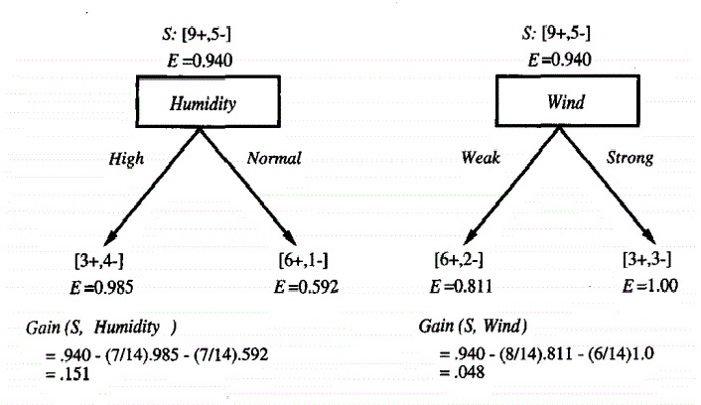
Information gain
Information gain is the measure used by the ID3 algorithm to identify the best attribute at any particular node of the tree
AI/ML Professional Training Program: INNOQUEST COHORT-1
Instructor: Prof. Ahmad Raza Shahid
Tom Mitchell, pp. 59, figure 3.3

Slide 53
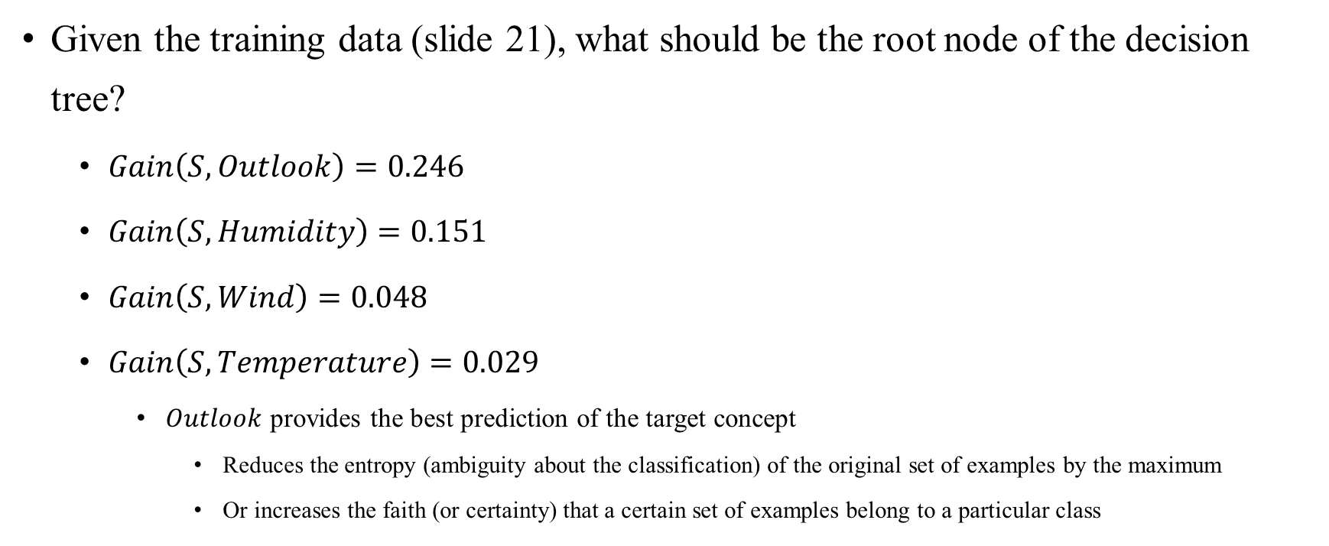
An illustrative example
Given the training data (slide 21), what should be the root node of the decision tree?
$Gain\left(S, Outlook\right)=0.246$
$Gain\left(S, Humidity\right)=0.151$
$Gain\left(S, Wind\right)=0.048$
$Gain\left(S, Temperature\right)=0.029$
$Outlook$ provides the best prediction of the target concept
Reduces the entropy (ambiguity about the classification) of the original set of examples by the maximum
Or increases the faith (or certainty) that a certain set of examples belong to a particular class
AI/ML Professional Training Program: INNOQUEST COHORT-1
Instructor: Prof. Ahmad Raza Shahid

Slide 54
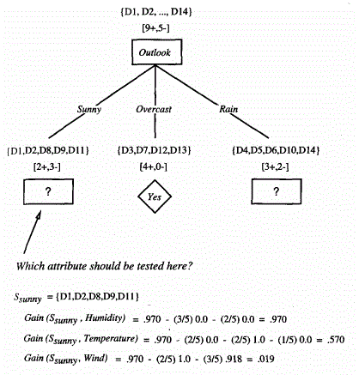
An illustrative example
Tom Mitchell, pp. 61, Figure 3.4
AI/ML Professional Training Program: INNOQUEST COHORT-1
Instructor: Prof. Ahmad Raza Shahid

Slide 55
An illustrative example
The process is repeated till
Either every attribute has already been included along this path through the tree
Or the training examples associated with this leaf node all have the same target attribute value (their entropy is zero)
AI/ML Professional Training Program: INNOQUEST COHORT-1
Instructor: Prof. Ahmad Raza Shahid

Slide 56
Hypothesis search space
The hypothesis space searched by the ID3 is the set of possible decision trees
Performs a simple-to-complex, hill-climbing search through this hypothesis space
Beginning with the empty tree
Constructing progressively more elaborate hypotheses in search of a decision tree that correctly classifies the training data
Information gain guides the search
AI/ML Professional Training Program: INNOQUEST COHORT-1
Instructor: Prof. Ahmad Raza Shahid

Slide 57
Hypothesis search space
ID3’s hypothesis space of all decision trees is a complete space of finite discrete-valued functions
Because every finite discrete-valued function can be represented by some decision tree
ID3 does not run the risk of searching incomplete hypothesis space, such as the ones which only consider conjunctive hypotheses
The search space that ID3 searches in always contains the target concept
AI/ML Professional Training Program: INNOQUEST COHORT-1
Instructor: Prof. Ahmad Raza Shahid

Slide 58
Hypothesis search space
ID3 maintains only a single current hypothesis as it searches through the space of decision trees
Contrasts with the Candidate-Elimination algorithm which maintains a set of consistent hypotheses
ID3 does not have the capability to explicitly represent all consistent hypotheses
Cannot determine how many alternative consistent hypotheses are available
Cannot pose queries (instances) to choose among these competing hypotheses
AI/ML Professional Training Program: INNOQUEST COHORT-1
Instructor: Prof. Ahmad Raza Shahid

Slide 59
Hypothesis search space
Does not perform any backtracking
Never reconsiders the choices made for attributes at particular nodes
Can converge to locally optimal solutions
ID3 uses a bunch of training examples at each step rather than taking one instance at a time
Is less susceptible to errors in any one instance
AI/ML Professional Training Program: INNOQUEST COHORT-1
Instructor: Prof. Ahmad Raza Shahid

Slide 60
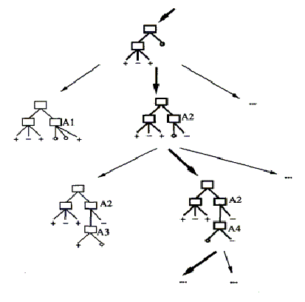
Hypothesis search space
Tom Mitchell, pp. 62, Figure 3.5
AI/ML Professional Training Program: INNOQUEST COHORT-1
Instructor: Prof. Ahmad Raza Shahid

Slide 61
Inductive bias
How ID3 generalizes beyond the seen instances?
Given a collection of training examples, there are typically many decision trees consistent with these examples
Inductive bias describes the basis by which it chooses one of these consistent hypotheses over the others?
AI/ML Professional Training Program: INNOQUEST COHORT-1
Instructor: Prof. Ahmad Raza Shahid

Slide 62
Inductive bias
ID3 chooses the first acceptable tree it encounters in its simple-to-complex, hill-climbing search through the space of possible trees
It selects in favor of shorter trees over longer trees
It selects trees that place the attributes with the highest information gain closest to the root
AI/ML Professional Training Program: INNOQUEST COHORT-1
Instructor: Prof. Ahmad Raza Shahid

Slide 63
Inductive bias
Preference for short decision trees over complex trees
“Shorter trees are preferred over longer trees. Trees that place high information gain attributes close to the root are preferred over those that do not.”
AI/ML Professional Training Program: INNOQUEST COHORT-1
Instructor: Prof. Ahmad Raza Shahid

Slide 64
Restriction biases vs Preference biases
ID3
Searches a complete hypothesis space
Searches incompletely
Inductive bias is solely a consequence of the ordering of hypotheses by its search strategy
Hypothesis space introduces no additional bias
AI/ML Professional Training Program: INNOQUEST COHORT-1
Instructor: Prof. Ahmad Raza Shahid

Slide 65
Restriction biases vs Preference biases
Candidate-Elimination algorithm
Searches an incomplete hypothesis space
Searches completely
Inductive bias solely a consequence of the expressive power of its hypothesis representation
Search strategy introduces no additional bias
AI/ML Professional Training Program: INNOQUEST COHORT-1
Instructor: Prof. Ahmad Raza Shahid

Slide 66
Restriction biases vs Preference biases
ID3
Inductive bias follows from its search strategy
Preference for certain hypotheses over others
Preference bias or a search bias
Candidate-Elimination algorithm
Inductive bias follows from the definition of its search space
Restriction on the set of hypotheses considered
Restriction bias or a language bias
AI/ML Professional Training Program: INNOQUEST COHORT-1
Instructor: Prof. Ahmad Raza Shahid

Slide 67
Restriction biases vs Preference biases
Typically a preference bias is more desirable than a restriction bias
Because it allows the learner to work within a complete hypothesis space
The restriction bias strictly limits the set of potential hypotheses
AI/ML Professional Training Program: INNOQUEST COHORT-1
Instructor: Prof. Ahmad Raza Shahid

Slide 68
Preferring shorter hypotheses
Occam’s razor
Prefer the simplest hypothesis that fits the data.
AI/ML Professional Training Program: INNOQUEST COHORT-1
Instructor: Prof. Ahmad Raza Shahid

Slide 69
Issues in decision tree learning
Determining how deeply to grow the decision tree
Handling continuous attributes
Choosing an appropriate attribute selection measure
Handling training data with missing attribute values
Handling attributes with differing costs
Improving computational efficiency
AI/ML Professional Training Program: INNOQUEST COHORT-1
Instructor: Prof. Ahmad Raza Shahid

Slide 70

Overfitting the data
Do longer trees help?
The ID3 algorithm can build trees that overfit the training data
Definition: Given a hypothesis space $H$, a hypothesis $h∈H$ is said to overfit the training data if there exists some alternative hypothesis $\acute{h}∈H$, such that $h$ has smaller error than $\acute{h}$ over the training examples, but $\acute{h}$ has a smaller error than $h$ over the entire distribution of instances.
AI/ML Professional Training Program: INNOQUEST COHORT-1
Instructor: Prof. Ahmad Raza Shahid

Slide 71

Overfitting the data
AI/ML Professional Training Program: INNOQUEST COHORT-1
Instructor: Prof. Ahmad Raza Shahid

Slide 72
Overfitting the data
How can a hypothesis perform better than another hypothesis on training data but worse on test data?
Training data contains noise (random errors)
AI/ML Professional Training Program: INNOQUEST COHORT-1
Instructor: Prof. Ahmad Raza Shahid

Slide 73

Overfitting the data
Noisy example
$\left\langle Outlook=Sunny, Temperature=Hot, Humidity=Normal, Wind=Strong, PlayTennis=No\right\rangle$
It will cause ID3 to construct a more complex tree
Will look for further refinements along a particular path in the tree
AI/ML Professional Training Program: INNOQUEST COHORT-1
Instructor: Prof. Ahmad Raza Shahid

Slide 74

Overfitting the data
It will find a new decision attribute to separate out this new example from the two previous positive examples at this tree node
Will output a more complex tree $h$ than the original tree $\acute{h}$
$h$ will fit the collection of training examples perfectly
Simpler $\acute{h}$ will not
AI/ML Professional Training Program: INNOQUEST COHORT-1
Instructor: Prof. Ahmad Raza Shahid

Slide 75
Overfitting the data
Random noise can lead to overfitting
Also small data size can lead to overfitting
When coincidental regularities exist
Some attribute happens to partition the examples very well
AI/ML Professional Training Program: INNOQUEST COHORT-1
Instructor: Prof. Ahmad Raza Shahid

Slide 76
Overfitting the data
How to avoid?
Stop growing the tree earlier, before it reaches the point where it perfectly classifies the training data
Difficulty in estimating precisely when to stop growing the tree
Allow the tree to overfit the data, and then post-prune it
Found to be more successful
AI/ML Professional Training Program: INNOQUEST COHORT-1
Instructor: Prof. Ahmad Raza Shahid

Slide 77
Overfitting the data
Correct final tree size
Use a separate set of examples, distinct from the training data to evaluate the utility of post-pruning nodes from the tree
Use all the available data for training
Apply a statistical test (e.g., chi-square) to estimate whether expanding (or pruning) a particular node is likely to produce an improvement beyond the seen instances
AI/ML Professional Training Program: INNOQUEST COHORT-1
Instructor: Prof. Ahmad Raza Shahid

Slide 78
Overfitting the data
Training and validation sets
Validation set is used to evaluate the accuracy of the learned hypothesis over the subsequent data
In particular to evaluate the impact of pruning this hypothesis
The reasoning behind it is that the noise and coincidental regularities existing in the training data, the validation set is unlikely to exhibit the same random fluctuations
AI/ML Professional Training Program: INNOQUEST COHORT-1
Instructor: Prof. Ahmad Raza Shahid

Slide 79
Reduced error pruning
Considers each of the decision nodes in the tree to be candidates for pruning
Pruning a decision node involves removing the subtree rooted at that node
Makes it a leaf node
Assigns it to the most common classification of the training examples affiliated with that node
Pruning is only done if the resultant tree performs no worse than the original over the validation set
AI/ML Professional Training Program: INNOQUEST COHORT-1
Instructor: Prof. Ahmad Raza Shahid

Slide 80
Reduced error pruning
Any leaf node added due to coincidental regularities in the training set is likely to be pruned
Because these same coincidences are unlikely to occur in the validation set
Pruning is done iteratively
First removing a node whose removal increases the accuracy over the validation set by the maximum
Pruning is done till it stops reaping benefits
AI/ML Professional Training Program: INNOQUEST COHORT-1
Instructor: Prof. Ahmad Raza Shahid

Slide 81
Rule post-pruning
Infer the decision tree from the training set
Growing it till the training data is fit as well as possible
Allowing overfitting to occur
Convert the learned tree into an equivalent set of rules by creating one rule for each path from the root node to a leaf node
AI/ML Professional Training Program: INNOQUEST COHORT-1
Instructor: Prof. Ahmad Raza Shahid

Slide 82
Rule post-pruning
Prune (generalize) each rule by removing any preconditions that result in improving its estimated accuracy
Sort the pruned rules by their estimated accuracy, and consider them in this sequence when classifying subsequent instances
AI/ML Professional Training Program: INNOQUEST COHORT-1
Instructor: Prof. Ahmad Raza Shahid

Slide 83

Rule post-pruning
Each attribute test along the path from the root to the leaf becomes a rule antecedent (precondition)
The classification at the leaf node becomes the rule consequent (postcondition)
$IF \left(Outlook=Sunny\right) ∧ \left(Humidity=High\right)$ $THEN PlayTennis=No$
AI/ML Professional Training Program: INNOQUEST COHORT-1
Instructor: Prof. Ahmad Raza Shahid

Slide 84

Rule post-pruning
Each such rule is pruned by removing any antecedent, or precondition, whose removal does not worsen its estimated accuracy
It would consider pruning
$\left(Outlook=Sunny\right)$
$\left(Humidity=High\right)$
Would first consider either of the above which produced the greatest improvement in accuracy
Then consider the next
AI/ML Professional Training Program: INNOQUEST COHORT-1
Instructor: Prof. Ahmad Raza Shahid

Slide 85
Rule post-pruning
Converting to rules allows distinguishing among the different contexts in which a decision node is used
Each distinct path produces a distinct rule
Pruning decision regarding an attribute can be made differently for each path
AI/ML Professional Training Program: INNOQUEST COHORT-1
Instructor: Prof. Ahmad Raza Shahid

Slide 86

Incorporating continuous-valued attributes
By partitioning the continuous attribute value into a discrete set of intervals
For an attribute $A$ that is continuous-valued, the algorithm can dynamically create a new boolean attribute $A_{c}$ that is true if $A<c$ and false otherwise
How to select the best value for the threshold $c$?
The one that produces the greatest information gain
AI/ML Professional Training Program: INNOQUEST COHORT-1
Instructor: Prof. Ahmad Raza Shahid

Slide 87

Incorporating continuous-valued attributes
One way is to identify a continuous attribute and sort examples according to it
A set of candidate thresholds can be generated midway between the corresponding values of $A$
It can be shown that the value of $c$ that maximizes information gain must always lie at such a boundary
Temperature | 40 | 48 | 60 | 72 | 80 | 90
PlayTennis | No | No | Yes | Yes | Yes | No
AI/ML Professional Training Program: INNOQUEST COHORT-1
Instructor: Prof. Ahmad Raza Shahid

Slide 88

Incorporating continuous-valued attributes
Candidate thresholds can then be evaluated by computing the information gain associated with each
2 candidate thresholds
(48 + 60)/2 ${Temperature}_{>54}$
(80 + 90)/2 ${Temperature}_{>85}$
AI/ML Professional Training Program: INNOQUEST COHORT-1
Instructor: Prof. Ahmad Raza Shahid

Slide 89

Missing attribute values
Missing values can be estimated based on other examples for which this attribute has a known value
Assign it the value that is most common among training examples at node $n$
Assign it the most common value among examples at node $n$ that have the classification $c\left(x\right)$
AI/ML Professional Training Program: INNOQUEST COHORT-1
Instructor: Prof. Ahmad Raza Shahid

Slide 90

Missing attribute values
Assigning a probability to each of the possible values of $A$
Can be obtained based on observed frequencies of the various values of $A$ among the examples at node $n$
If node $n$ contains six known examples with $A=1$ and four with $A=0$
Probability that $A\left(x\right)=1$ is $0.6$
Probability that $A\left(x\right)=0$ is $0.4$
AI/ML Professional Training Program: INNOQUEST COHORT-1
Instructor: Prof. Ahmad Raza Shahid

Slide 91
Regression vs Decision Tree
Summary Table:
Aspect | Regression Tree | Decision Tree
Task Type | Regression (continuous value prediction) | Classification (discrete class prediction)
Prediction | Mean of target values in leaf nodes | Mode (most frequent class) in leaf nodes
Splitting Criterion | Minimizes variance (MSE) | Maximizes information gain, Gini impurity, or entropy
Output | Continuous value | Class label
Use Case | Predicting numerical values (e.g., prices) | Classifying into categories (e.g., spam detection)
AI/ML Professional Training Program: INNOQUEST COHORT-1
Instructor: Prof. Ahmad Raza Shahid

Slide 92
Ensemble Learning
Ensemble Learning Overview
Definition: Combines two or more models (e.g., regression, neural networks) to improve prediction accuracy.
Principle: A collection of models (ensemble) performs better than a single model.
Applications: Proven effective in machine learning and convolutional neural networks (CNNs).
Key Terms
Base Learner: Individual model used in ensemble algorithms.
Strong Learner: Achieves high accuracy (≥80% in binary classification).
Weak Learner: Performs slightly better than random guessing (~50% accuracy in binary classification).
AI/ML Professional Training Program: INNOQUEST COHORT-1
Instructor: Prof. Ahmad Raza Shahid

Slide 93
Ensemble Learning
Why use ensemble learning?
Bias-Variance Tradeoff
Overview: A key concept in machine learning, fundamental to regularization techniques.
Key Relationships
Bias and variance inversely represent:
Training accuracy (bias).
Testing/validation accuracy (variance).
Total Model Error = Bias² + Variance + Irreducible Error.
Irreducible Error: Randomness inherent in the dataset.
Impact
Low Bias + High Variance: Overfitting.
High Bias + Low Variance: Underfitting.
Effective model training balances bias and variance
AI/ML Professional Training Program: INNOQUEST COHORT-1
Instructor: Prof. Ahmad Raza Shahid

Slide 94

Types of ensemble models
Parallel Methods:
Train each base learner independently of others.
Base learners are trained simultaneously.
Sequential Methods:
Train a new base learner to minimize errors made by the previous one.
Construct base models in sequential stages.
Key Differences
Parallel: Focuses on combining independent models (e.g., Random Forest).
Sequential: Focuses on correcting errors iteratively (e.g., Boosting
AI/ML Professional Training Program: INNOQUEST COHORT-1
Instructor: Prof. Ahmad Raza Shahid

Slide 95
Ensemble Learning Techniques
i. Voting
Purpose: Combines predictions from base learners into a final prediction.
Types of Voting:
Majority Voting:
Each base learner casts a "vote" for its prediction.
Final prediction is determined by the majority.
Example: For binary classification, the majority class prediction is used.
Weighted Majority Voting:
Assigns greater weight to certain base learners.
Learners with higher importance or accuracy influence the final prediction more.
AI/ML Professional Training Program: INNOQUEST COHORT-1
Instructor: Prof. Ahmad Raza Shahid

Slide 96

Ensemble Learning Techniques
ii. Bagging (Bootstrap aggregating)
What is Bagging?
A machine learning ensemble technique that improves model stability and accuracy.
Combines predictions from multiple models to reduce variance and overfitting.
How it Works:
Bootstrap Sampling:
Generate multiple subsets of the training data by sampling with replacement.
Model Training:
Train a separate model (e.g., Decision Tree) on each subset.
Aggregation:
Combine predictions from all models:
Classification: Majority voting.
Regression: Average predictions.

Slide 97

Ensemble Learning Techniques
iii. Stacking
Definition: Parallel ensemble method using meta-learning.
Process:
Train multiple base learners with different algorithms.
Base learners predict on a separate dataset.
Train a meta-learner using these predictions.
Key Points:
Use different datasets for base learners and meta-learner to avoid overfitting.
Cross-validation ensures dataset separation.
Benefit: Combines diverse models for improved performance
AI/ML Professional Training Program: INNOQUEST COHORT-1
Instructor: Prof. Ahmad Raza Shahid

Slide 98

Ensemble Learning Techniques
iv. Boosting
Boosting is a sequential ensemble method.
Starts by training a weak learner on the initial dataset (d1d_1), often misclassifying samples.
Creates new datasets (d2,d3,…d_2, d_3, \dots) by prioritizing misclassified samples and disagreements from previous learners.
Process repeats nn times, producing nn learners.
Final predictions are made by combining and weighting all learners.
Key difference from bagging: Focuses on misclassified samples rather than random sampling.

Slide 99
Types of Boosting
1. AdaBoost (Adaptive Boosting):
Approach: Reweights misclassified samples, increasing their importance in subsequent iterations.
Goal: Focuses on correcting misclassifications by giving harder-to-predict samples more weight.
Mechanism: Misclassified samples are given higher weights, and each learner focuses on correcting the errors of previous ones.
2. Gradient Boosting:
Approach: Uses residual errors (differences between predicted and actual values) from previous models.
Goal: Reduces overall error by training new models on the residuals to improve predictions incrementally.
Mechanism: Each new model is trained to predict residuals from prior models, correcting past errors.

Slide 100

Random Forests
Random Forest Algorithm
What is it?
An ensemble machine learning technique based on multiple Decision Trees.
How it Works:
Trains each tree on a random subset of data and features.
Combines outputs from all trees:
Classification: Majority voting.
Regression: Average predictions.
Key Benefits:
Reduces overfitting by leveraging diversity among trees.
Handles complex datasets effectively.
Produces stable and accurate predictions.
Applications:
Suitable for both classification and regression tasks in diverse domains
AI/ML Professional Training Program: INNOQUEST COHORT-1
Instructor: Prof. Ahmad Raza Shahid

Slide 101

XGboost
Introduction to XGBoost
eXtreme Gradient Boosting (XGBoost): Advanced gradient boosting algorithm.
Developed by: Tianqi Chen.
Key Features:
Speed, performance, and scalability.
Popular for classification, regression, and ranking tasks.
Improvements over traditional GBDT:
Regularization techniques.
Distributed computing support.
Enhanced algorithmic innovations.

Slide 102
XGboost
How XGBoost Works
Boosting: Iterative technique to train weak learners (typically decision trees).
Process:
Initial sample weights are equal.
First learner trains and increases weights of misclassified samples.
Weights are adjusted in each iteration to prioritize hard-to-predict samples.
Learners' predictions are combined, with more accurate ones contributing more.
Stops after a predefined number of iterations or when validation performance plateaus.
Enhancements in XGBoost:
Second-order gradient optimization for efficient loss function optimization.
Regularization to prevent overfitting.
Efficient handling of large datasets for faster computation and scalability.
AI/ML Professional Training Program: INNOQUEST COHORT-1
Instructor: Prof. Ahmad Raza Shahid

Slide 103
XGboost
Data Preparation
Handling Missing Values:
XGBoost does not impute or delete missing values.
Learns optimal splits for missing data based on gradients and feature values.
Minimizes the impact of missing data on predictive performance.
AI/ML Professional Training Program: INNOQUEST COHORT-1
Instructor: Prof. Ahmad Raza Shahid

Slide 104
XGboost
Initialize Parameters
Setting Hyperparameters:
Hyperparameters must be set before training.
Objective Function and Evaluation Metric:
Objective function consists of two parts:
Loss function: Measures model error.
Regularization term: Prevents overfitting.
The loss function varies depending on the task (e.g., classification, regression).
Train the First Weak Learner
Building the First Tree:
The first weak learner is a decision tree that minimizes the loss function.
XGBoost uses both first-order (gradients) and second-order (Hessians) gradients.
Second-Order Gradient:
Provides more information about the curvature of the loss function.
Enables precise model adjustments, improving stability and speed compared to algorithms using only first-order gradients.
AI/ML Professional Training Program: INNOQUEST COHORT-1
Instructor: Prof. Ahmad Raza Shahid

Slide 105
XGboost
Build Subsequent Trees
Subsequent Trees and Parallelization:
Each new tree fits the pseudoresiduals from the previous model.
Greedy algorithm: Best splits are chosen based on the feature that minimizes the loss the most.
Parallelization: XGBoost builds multiple trees in parallel using multiple CPU cores, reducing training time, especially with large datasets.
Pruning:
Pre-pruning: Limits the number of sections in a tree and the minimum samples for a split (min_child_weight).
Post-pruning: Grows the tree first, then prunes branches that don't improve performance, reducing overfitting and improving model generalization.
AI/ML Professional Training Program: INNOQUEST COHORT-1
Instructor: Prof. Ahmad Raza Shahid

Slide 106
XGboost
Regularization and Shrinkage
Regularization (L1 and L2):
XGBoost includes L1 (Lasso) and L2 (Ridge) regularization in its objective function.
Helps prevent overfitting by penalizing overly complex models.
Shrinkage:
Applied after adding each tree to reduce the contribution of new trees.
Ensures gradual learning, improving convergence and reducing the risk of overfitting.
AI/ML Professional Training Program: INNOQUEST COHORT-1
Instructor: Prof. Ahmad Raza Shahid

Slide 107
XGboost
Evaluate and Combine Models
Model Aggregation:
Predictions from all trees are combined using a weighted sum.
Trees with better performance (lower loss) have higher weights and contribute more to the final prediction.
Final Prediction:
The final output is the sum of all weak learners (trees), scaled by the learning rate.
For classification, the output is typically transformed using a sigmoid function to generate probabilities.
Repeat Until Stopping Criterion is Met
Stopping Criteria:
The boosting process continues until a stopping condition is met.
Early Stopping:
Monitors performance on a validation set during training.
Stops training early to prevent overfitting, improving generalization.
AI/ML Professional Training Program: INNOQUEST COHORT-1
Instructor: Prof. Ahmad Raza Shahid

Slide 108
XGboost
Final Model
Weighted Ensemble:
The final model is an ensemble of all trained weak learners (trees).
Each tree contributes to the prediction based on its accuracy and importance.
Model Deployment:
After training, XGBoost can predict on unseen data.
Optimized for fast predictions and efficient handling of large datasets in production.
Model Interpretation and Feature Importance:
XGBoost provides feature importance scores.
Scores show which features most influence the final prediction, enhancing model transparency.
AI/ML Professional Training Program: INNOQUEST COHORT-1
Instructor: Prof. Ahmad Raza Shahid

Slide 109
XGBoost
Classification
Excels in complex classification challenges by transforming weak classifiers into a powerful ensemble.
Handles imbalanced classes, noisy data, and overlapping categories effectively.
Monotonic constraints allow domain-specific insights to be incorporated, improving interpretability and relevance.
Feature importance scores help prioritize the most impactful predictors, aiding transparent decision-making.
Applications: Healthcare, finance, cybersecurity.
Example: Identifying fraudulent credit card transactions.
AI/ML Professional Training Program: INNOQUEST COHORT-1
Instructor: Prof. Ahmad Raza Shahid

Slide 110
Thank You !!!
AI/ML Professional Training Program: INNOQUEST COHORT-1
Instructor: Prof. Ahmad Raza Shahid

